Slide 1

Human Development Index
Tejamanikanta, Gudla
Instructor: Ms. Gahangir Hossain
INFO 5709 - Data Visualization

Slide 2
Contents
Introduction
Dataset Overview
Components of HDI
Trends
Hypothesis
Dashboard
Future Goals on HDI in 2030
Conclusion
References

Slide 3
Introduction
The Human Development Index (HDI) is a widely recognized and comprehensive measure of human development and well-being within a country. It was introduced by the United Nations Development Programme (UNDP) in 1990 as a means to assess and compare the progress of nations in terms of their social and economic development.

Slide 4
Dataset Overview
The Human Development Index (HDI) and Components dataset is a comprehensive collection of data related to the HDI and its various components for multiple countries.
It provides insights into the social and economic development of countries across different regions.
Columns in Dataset are HDI rank, Country, HUMAN DEVELOPMENT, Human Development Index (HDI), Life expectancy at birth, Expected years of schooling, Mean years of schooling, Gross national income (GNI) per capita and GNI per capita rank minus HDI rank

Slide 5
Components of HDI
The Human Development Index (HDI) and Components dataset is a comprehensive collection of data related to the HDI and its various components for multiple countries.
It provides insights into the social and economic development of countries across different regions.
Columns in Dataset are HDI rank, Country, HUMAN DEVELOPMENT, Human Development Index (HDI), Life expectancy at birth, Expected years of schooling, Mean years of schooling, Gross national income (GNI) per capita and GNI per capita rank minus HDI rank

Slide 6
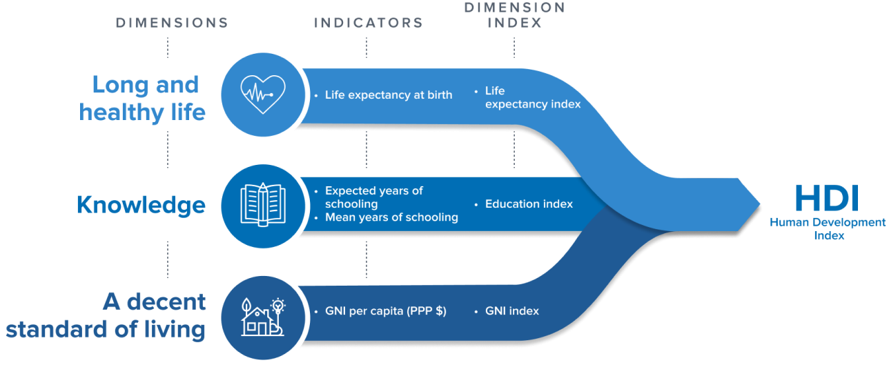

Slide 7
Trends

Slide 8
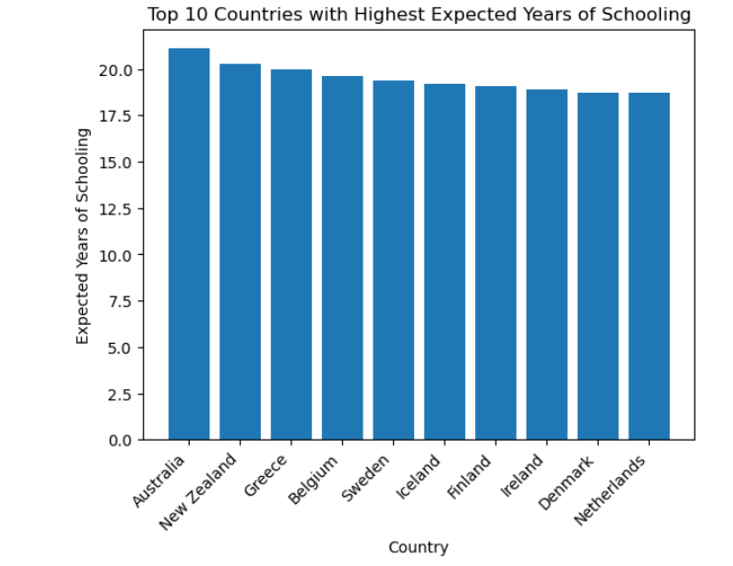
1. Bar Plot Top 10 countries with the highest Expected_years_of_schooling
Australia has the highest value of 21.1 Years.

Slide 9
Hypothesis

Slide 10
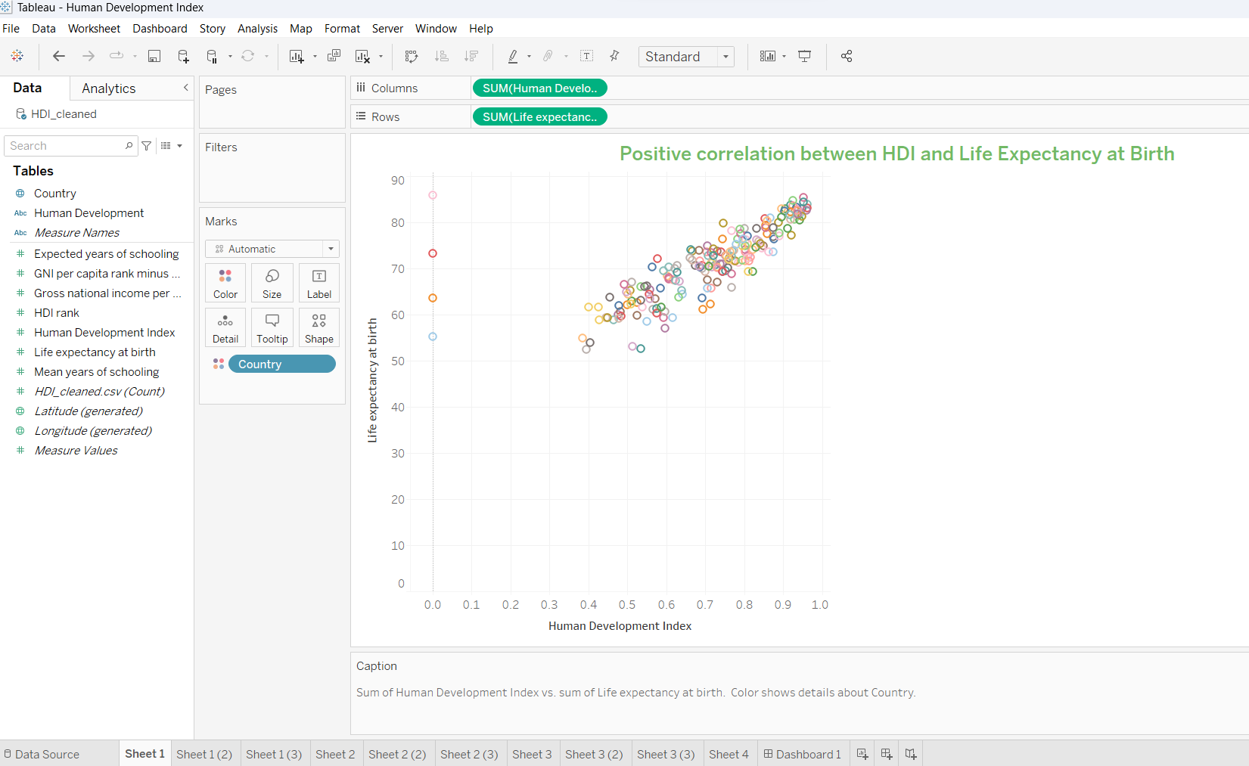
1.Positive correlation between HDI and Life Expectancy at Birth.
In this scatter plot shows the relationship between the Human Development Index (HDI) and life expectancy at birth for all countries. Monaco has the highest Life expectancy with value of 85.90.

Slide 11
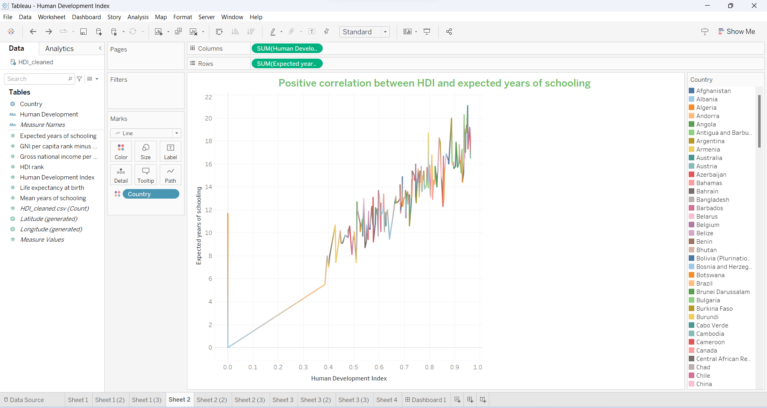
2.Positive correlation between HDI and Expected year of schooling
Line plot shows Countries in Europe and North America tend to have a higher HDI and expected years of schooling than countries in Africa and Asia.

Slide 12
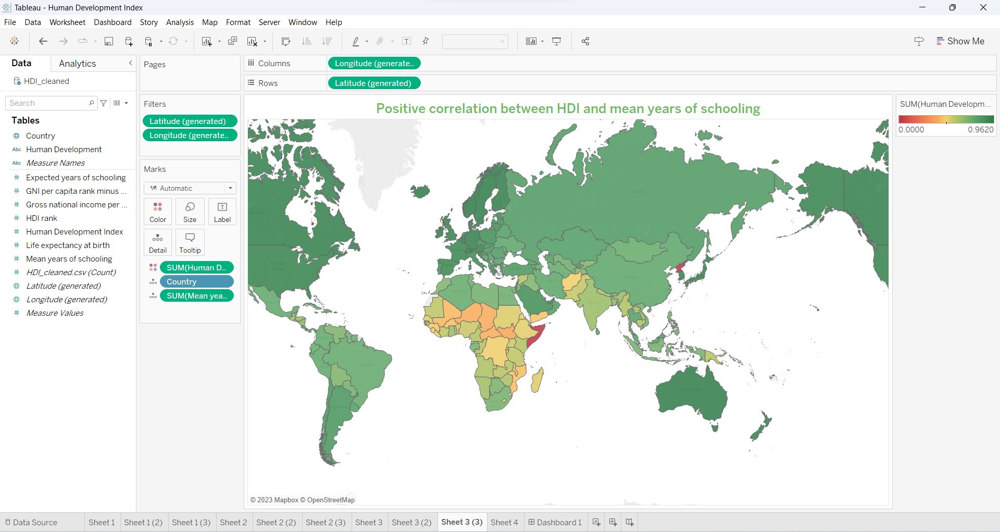
3.Positive correlation between HDI and Mean year of Schooling.
From map we can see that African countries has the lowest HDI and those are need to develop in terms of schooling and living aspects but coming to Europe or US has high HDI which is a symbol of developed countries as HDI is one of the key aspects.

Slide 13
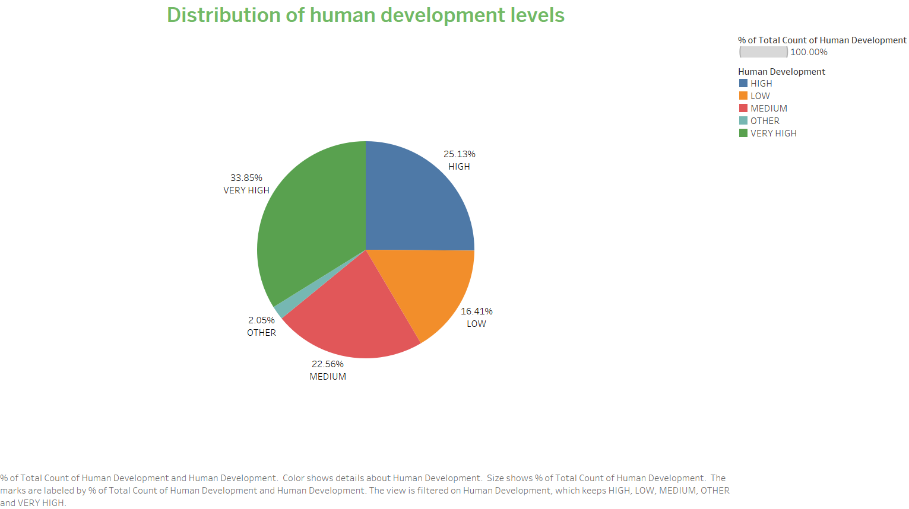
4.Distribution of Human Development levels.
The pie chart shows the distribution of human development levels in the world. The very high level is 33.8%, which means that a third of the world's countries have a very high level of human development. This is followed by the High level, which is 25.1%. The other levels are medium, low, and other. That shows most of the countries are being developed in terms of Human Development.

Slide 14
Dashboard

Slide 15
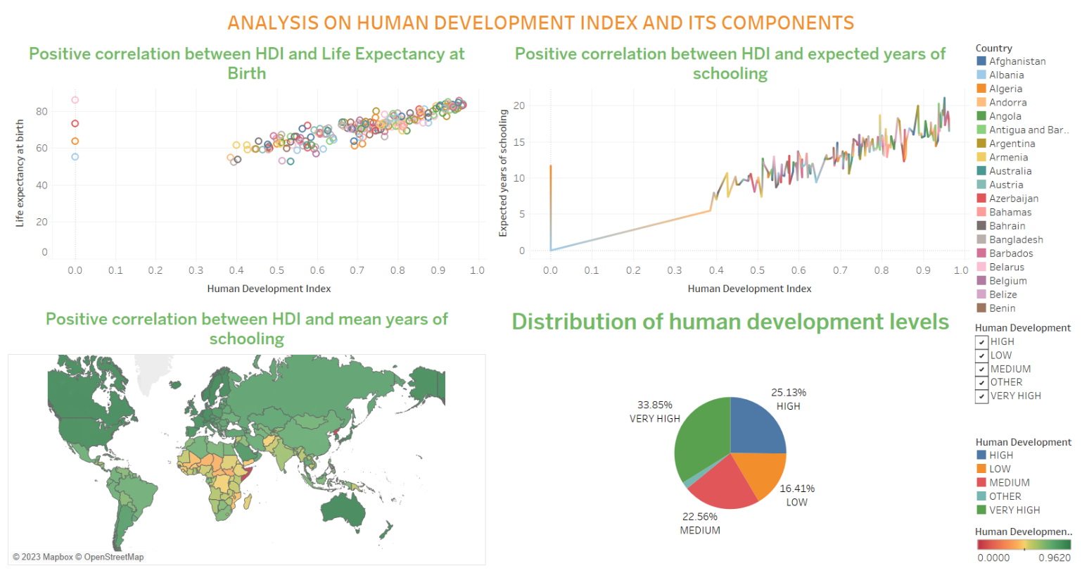
The Human Development Index (HDI) is a measure of human development. The HDI is composed of three components: life expectancy at birth, expected years of schooling, and mean years of schooling. There is a positive correlation between HDI and each of its components. Countries with higher HDIs tend to have longer life expectancies, more years of schooling, and higher incomes.

Slide 16
Future Goals on HDI in 2030
End Poverty in all its Forms: To eradicate extreme poverty and reduce overall poverty rates by implementing social protection measures, promoting sustainable livelihoods, and ensuring equal access to resources and opportunities.
Zero Hunger: To achieve food security, improved nutrition, and sustainable agriculture practices that can provide adequate nutrition and support livelihoods for all.
Good Health and Well-being: To ensure healthy lives and promote well-being for people of all ages by providing access to essential healthcare services, reducing maternal and child mortality, and combating communicable and non-communicable diseases.
Quality Education: To ensure inclusive and equitable education for all, promoting lifelong learning opportunities, and enhancing the quality of education to equip individuals with necessary skills for personal and societal development.

Slide 17
Conclusion
In Conclusion, this information provides an overview of the Human Development Index (HDI), discusses global trends and regional variations in HDI, analyzes country-specific HDI, and explores the factors influencing HDI such as education, healthcare, and income levels. In conclusion, the presentation summarizes the key findings and emphasizes the importance of HDI as a measure of human development.

Slide 18
References
[1]. Human Development Index Data Set is collected from Kaggle.
https://www.kaggle.com/datasets/rajkumarpandey02/human-development-index-and-components
[2]. Human Development Index by UNDP.
https://hdr.undp.org/
[3]. Human Development Index information using Wikipedia.
https://en.wikipedia.org/wiki/Human_Development_Index
[4]. HDI by World Population Review
https://worldpopulationreview.com/country-rankings/hdi-by-country

Slide 19
Thank You

